Slide 1
Advancing River Monitoring: High-Resolution Surface Velocity Measurement Using Range-Doppler Radar from Moving Platforms
Grubesa, Sanja; Drmic Luka; Orlic, Niksa; Grubesa, Tomislav
www.geolux-radars.com

Slide 2
Traditional hydrometric monitoring
Traditional hydrometric monitoring:
relies on station-based, in-situ measurements.
Parameters:
                water surface elevation,
                flow velocity,
                bed geometry
                river discharge
are recorded using sensors installed directly in or near the flow.
A few examples of measurements…

Slide 3
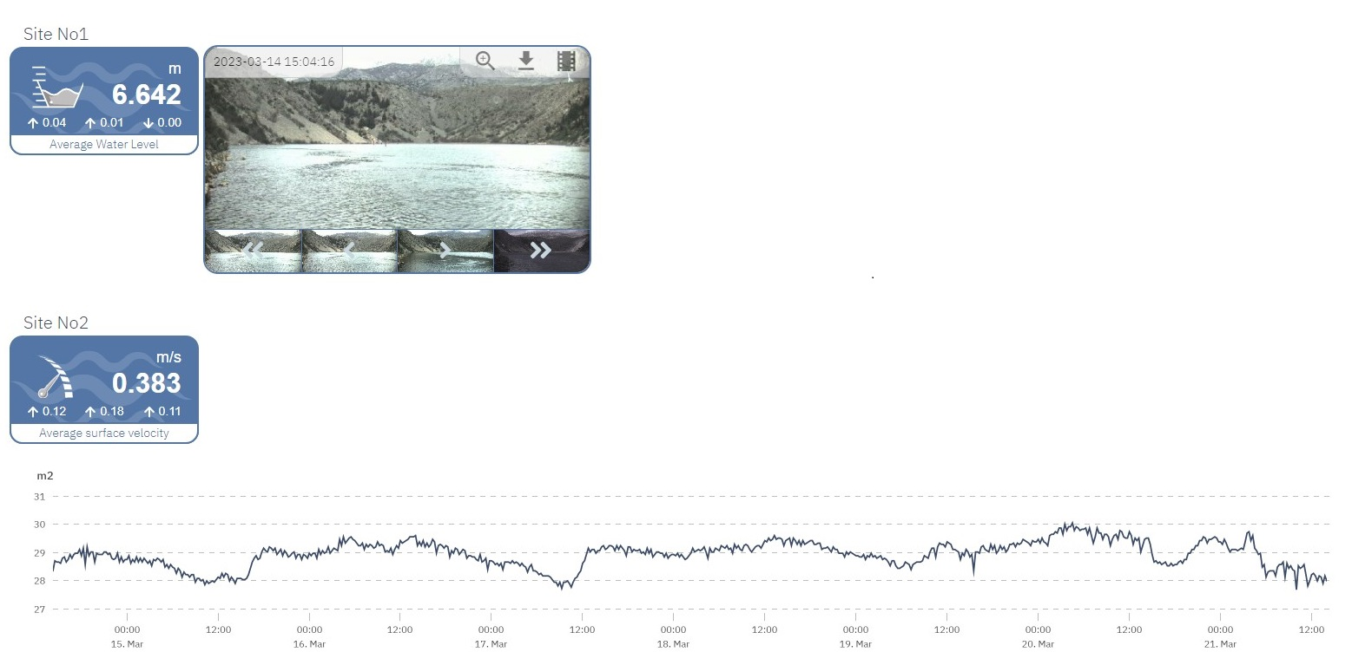
Flow Velocity Measurements

Slide 4
Measuring River Discharge

Slide 5
Results
In this study, we analyzed velocity measurements obtained using range-Doppler radar and compared them to traditional Doppler radar experiments.
We installed a Doppler radar and a range-Doppler radar on unmanned aerial vehicles (UAVs) to measure water surface velocity.

Slide 6
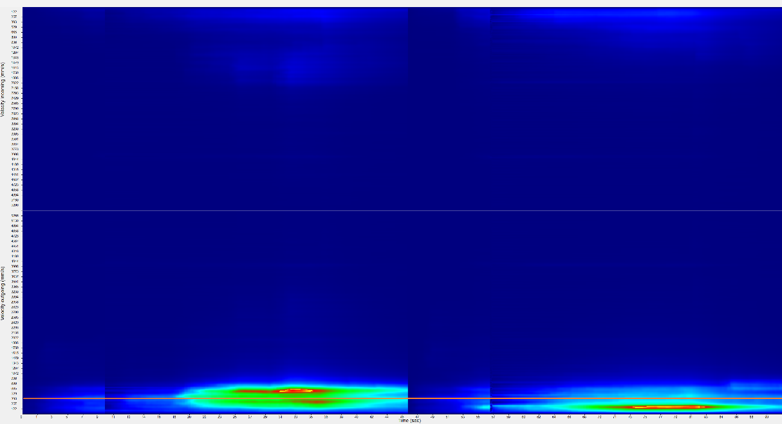
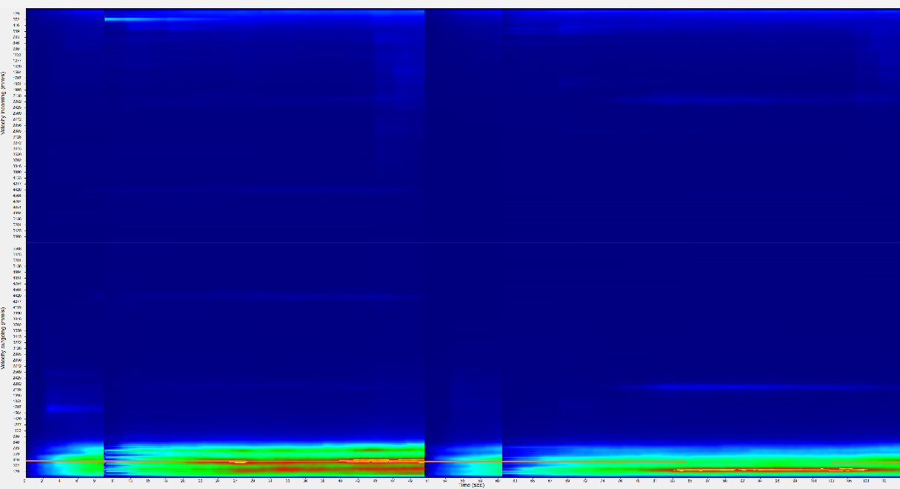
Measurements with Doppler radar mounted on UAV
UAV hovering at a fixed point above the water at a height of 1 m
UAV hovering at a fixed point above the water at a height of 2 m

Slide 7
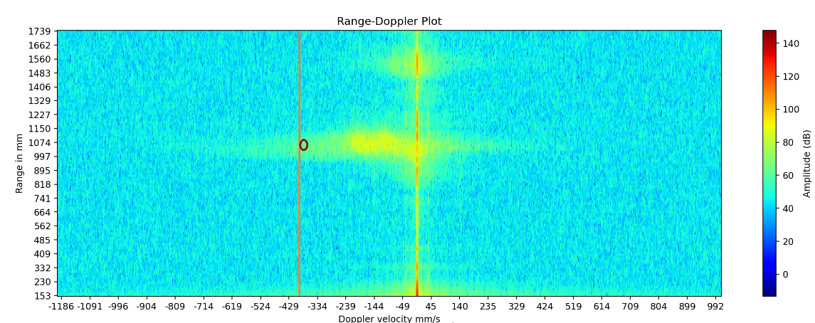
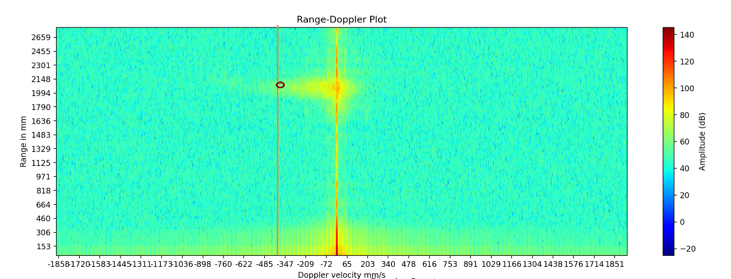
Measurements with range-Doppler radar mounted on UAV
UAV hovering at a fixed point above the water at a height of 1 m
UAV hovering at a fixed point above the water at a height of 2 m

Slide 8
Conclusion
The key advantage of range-Doppler radar is its ability to capture both range and Doppler information simultaneously, providing a more comprehensive view of the velocity profile across a given surface
Range-Doppler radar can achieve higher resolution and wider spatial coverage compared to conventional radar systems, making it particularly useful for large-scale water observation

